Slide 1
Create an Microservice on Eclipse IDE
and deploy it on IBM Bluemix
Arpit Jain

Slide 2
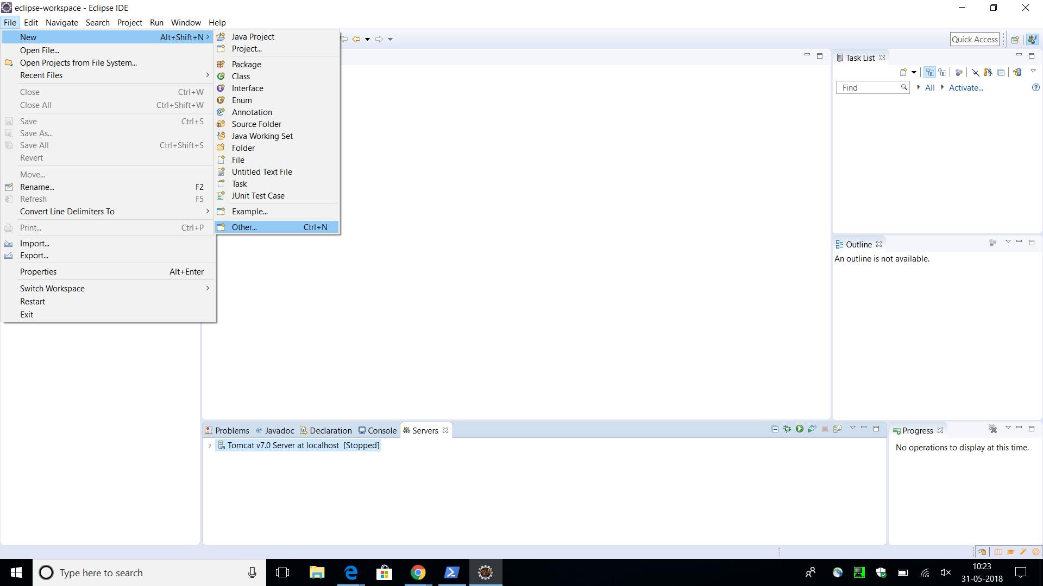
Step 1 : Open an eclipse EE workspace
Step 2: Create a new Dynamic web project

Slide 3
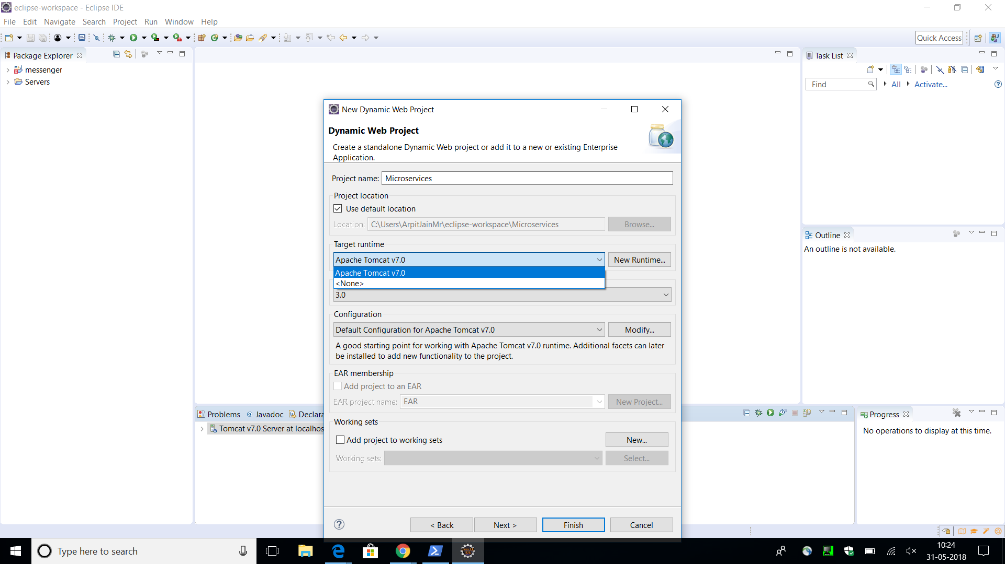
Step 3: Search IBM Bluemix in target runtime

Slide 4
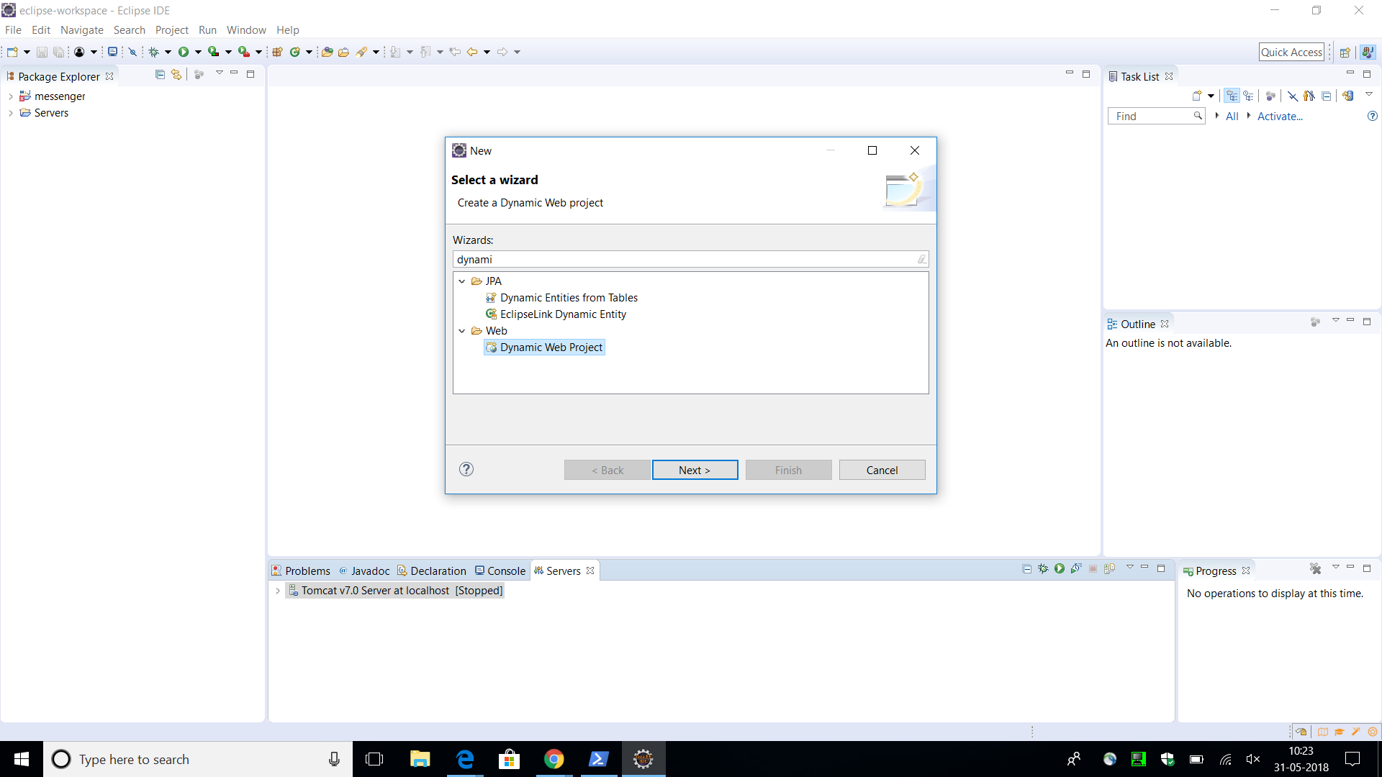
Step 4: Select Dynamic web project and hit next.

Slide 5
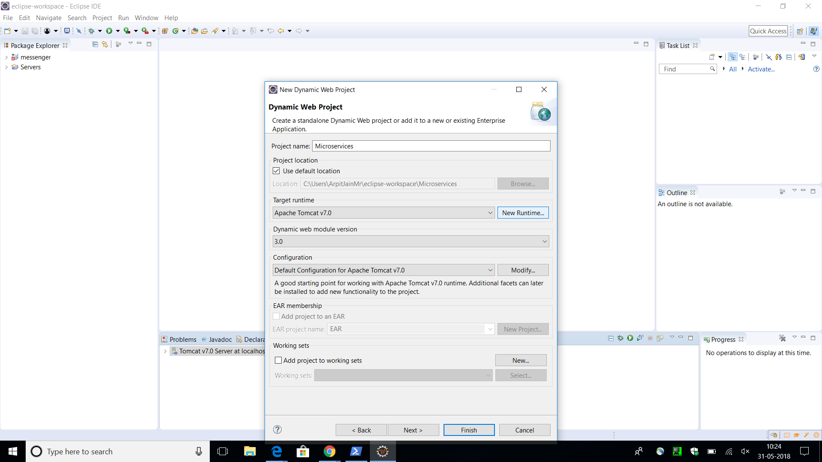
Step 5: Click on New Runtime button to install IBM Bluemix runtime if you don’t have Bluemix

Slide 6
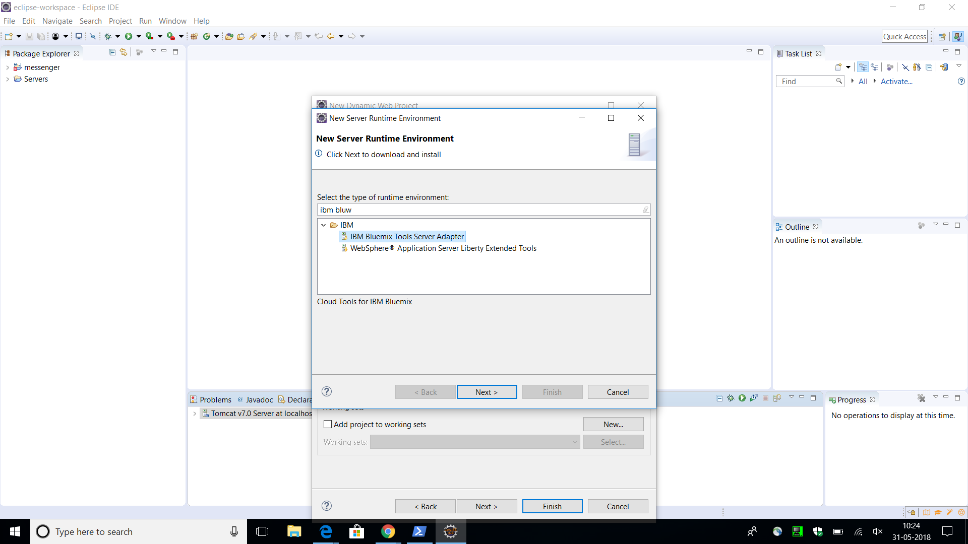
Step 6: Search IBM Bluemix runtime and select IBM Bluemix tool adapter

Slide 7
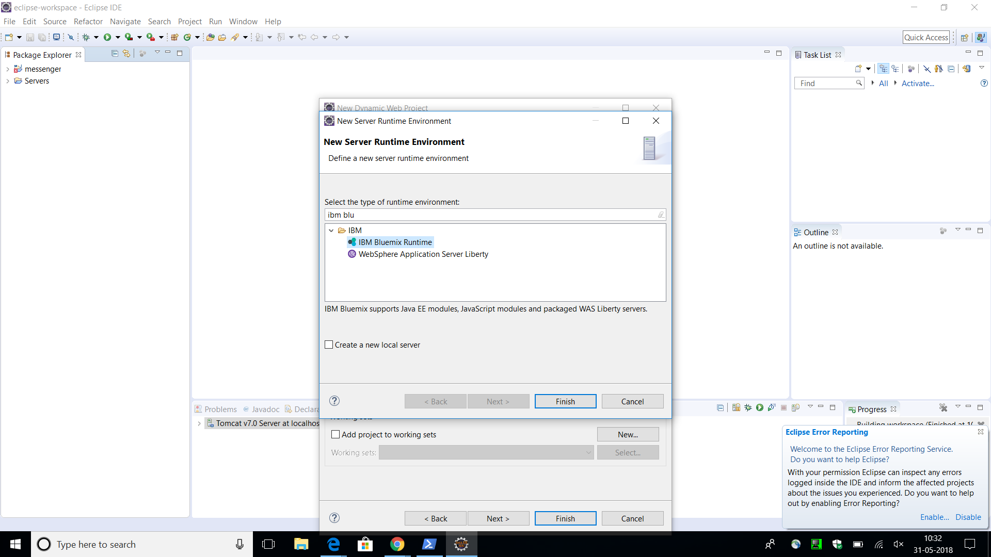
Step 7: Select IBM Bluemix Runtime and hit Finish.

Slide 8
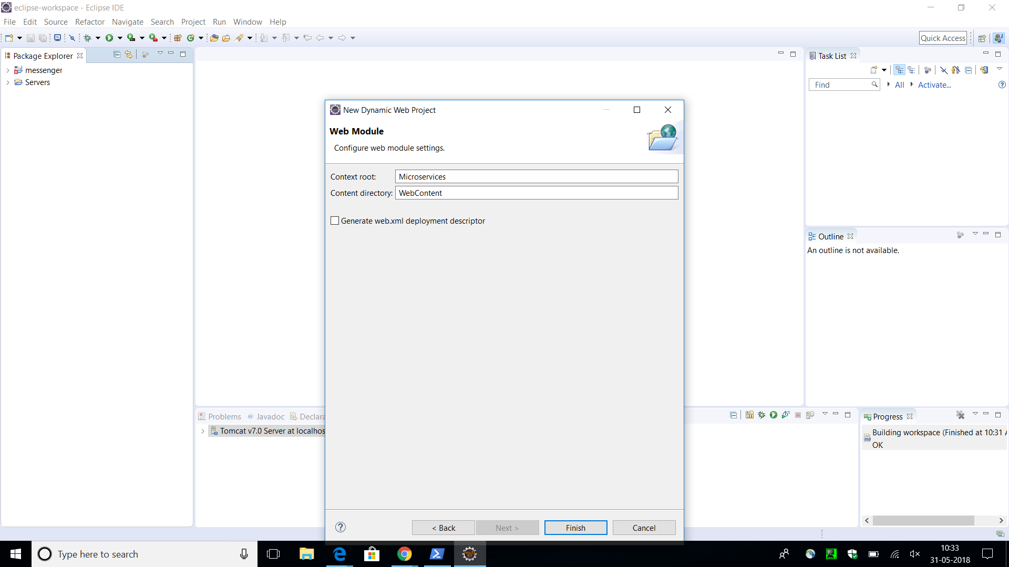
Step 8: Select the check box.

Slide 9
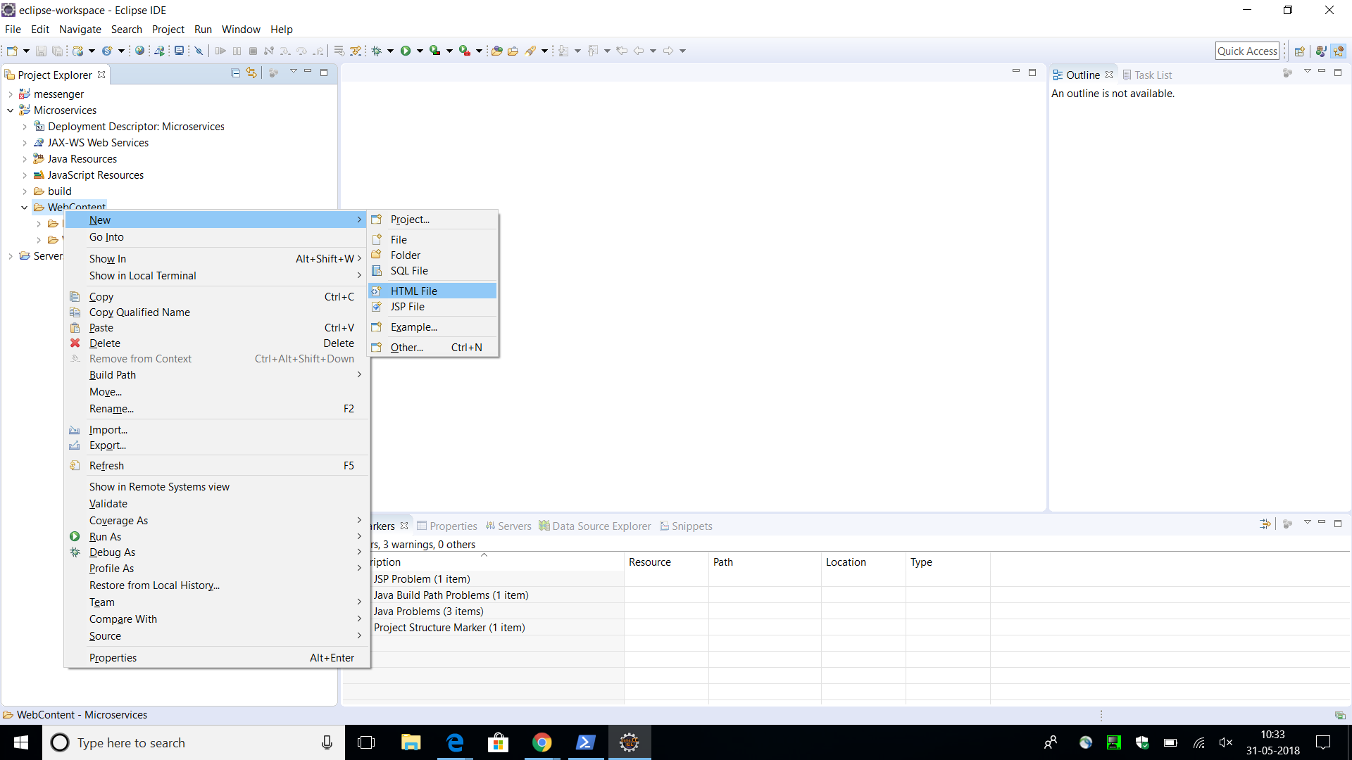
Step 9: Create a new HTML file in Web Content folder

Slide 10
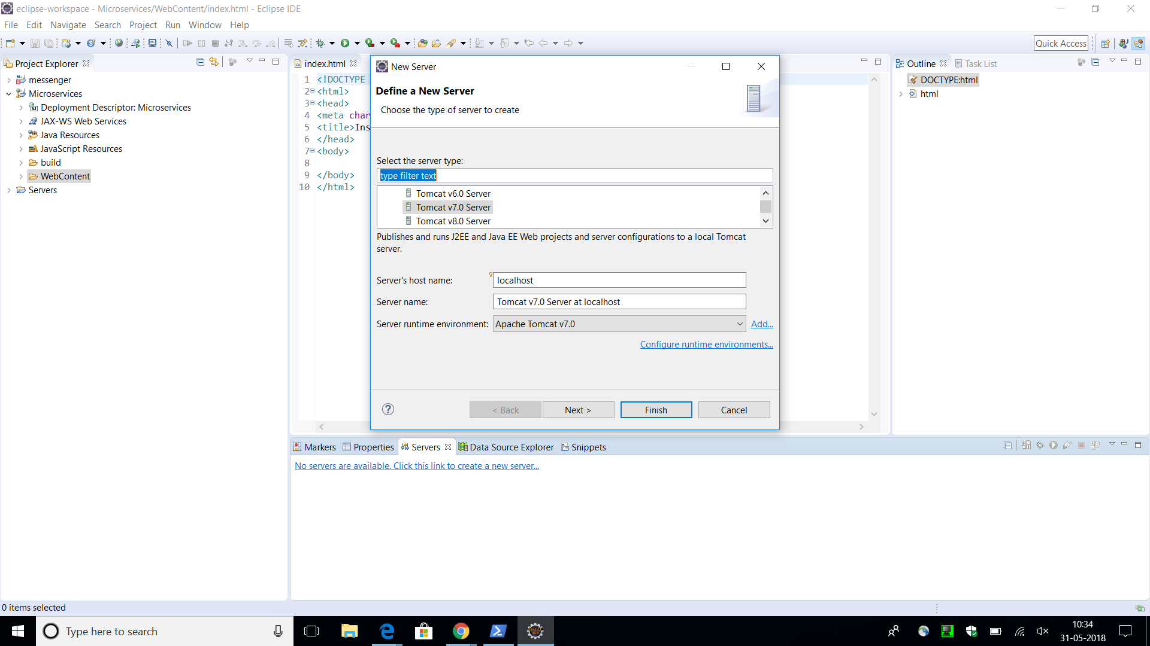
Step 10: Create a new server i.e. IBM Bluemix

Slide 11
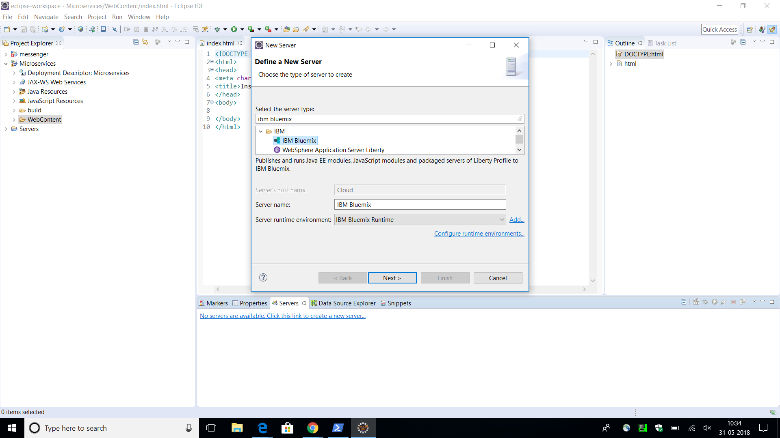
Step 11: Select IBM Bluemix as server.

Slide 12
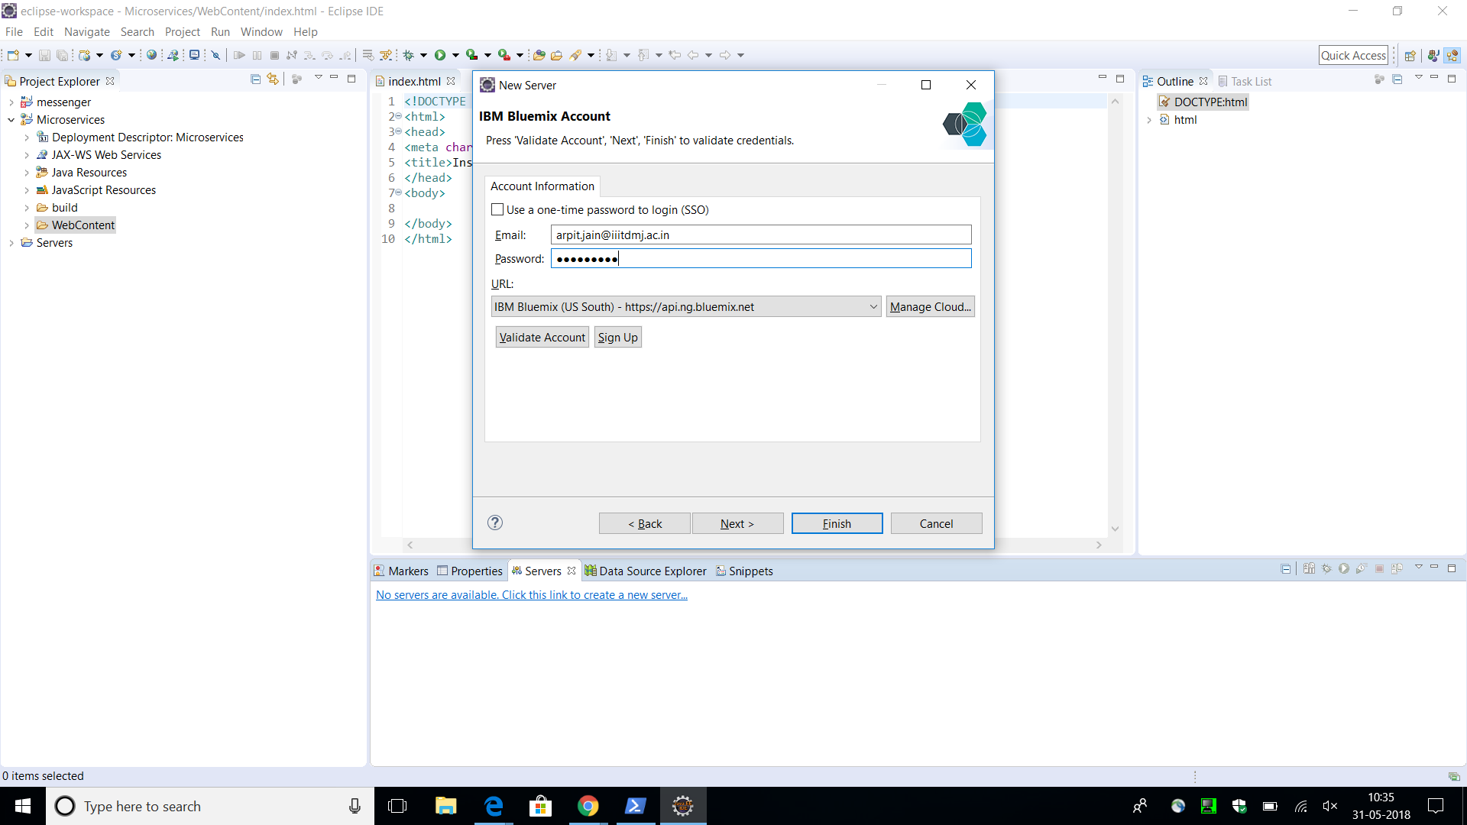
Step 12: Enter IBM Bluemix Account credentials.

Slide 13
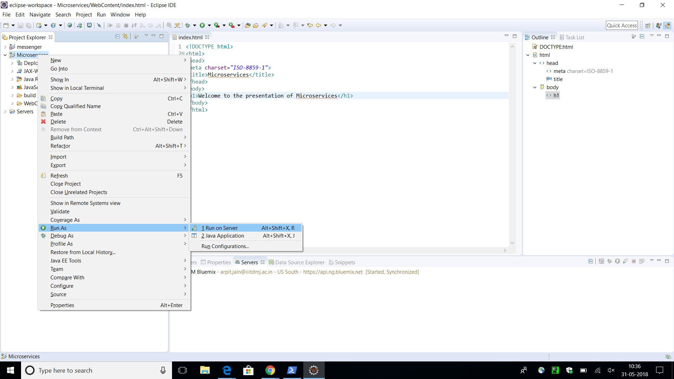
Step 13: Right click on application them select Run as- Run on server.

Slide 14
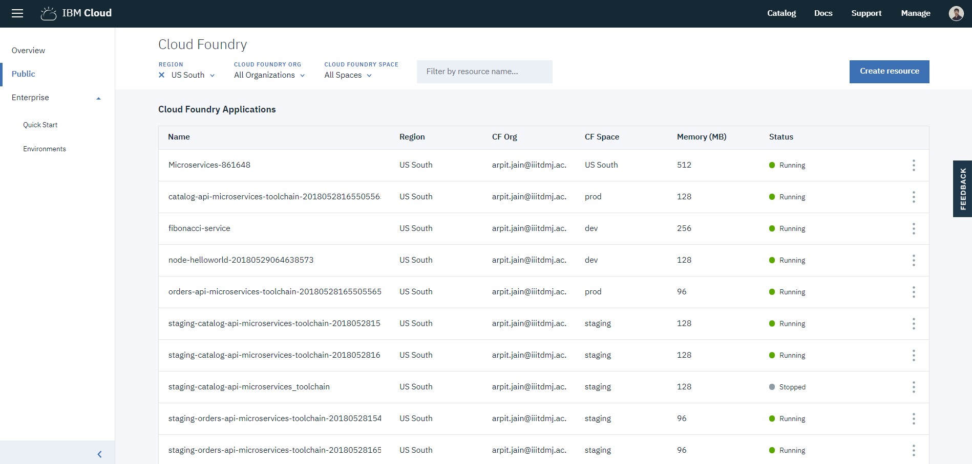
Application is created in IBM Cloud Foundry Applications

Slide 15
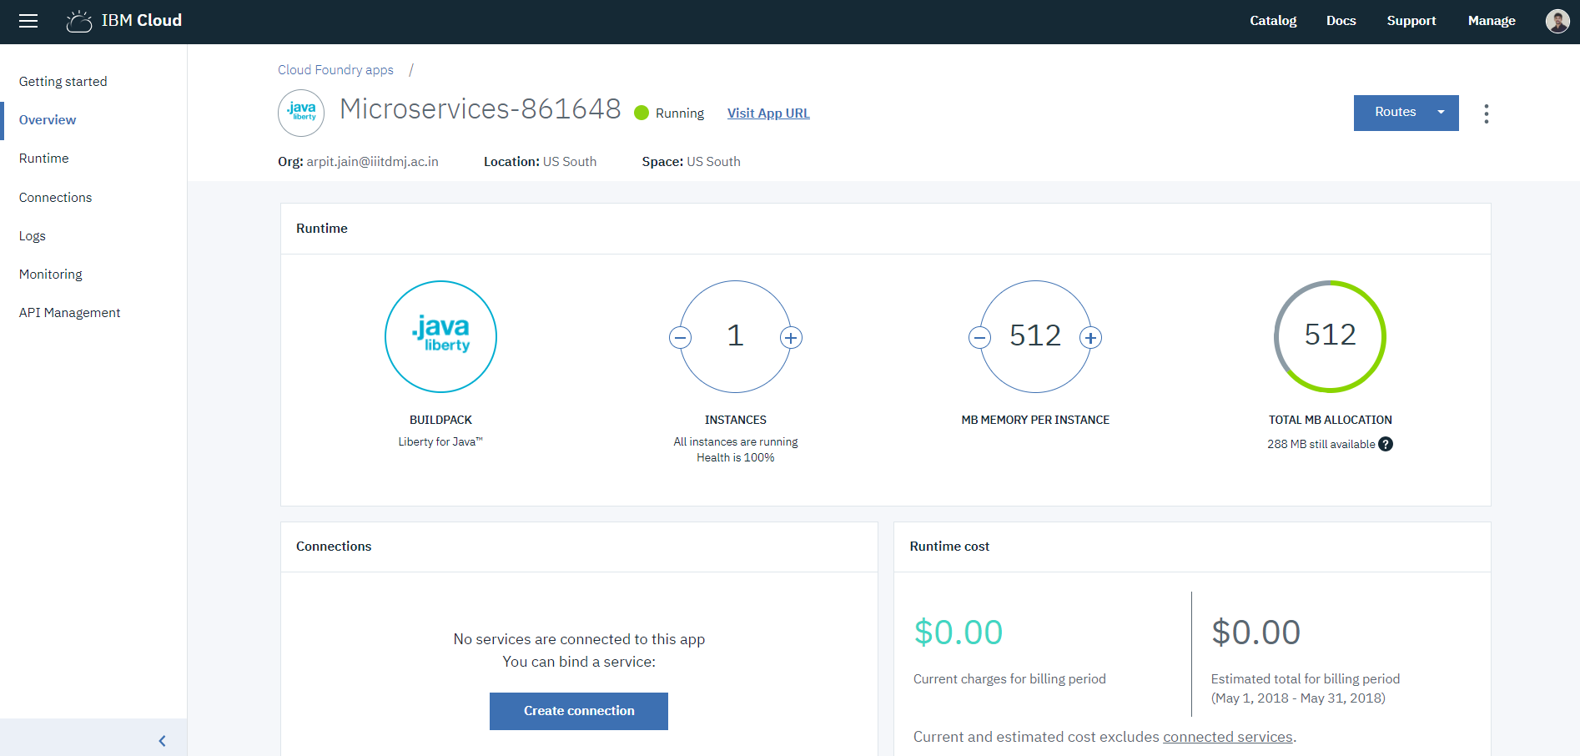
Application is running on the IBM Bluemix server.

Slide 16
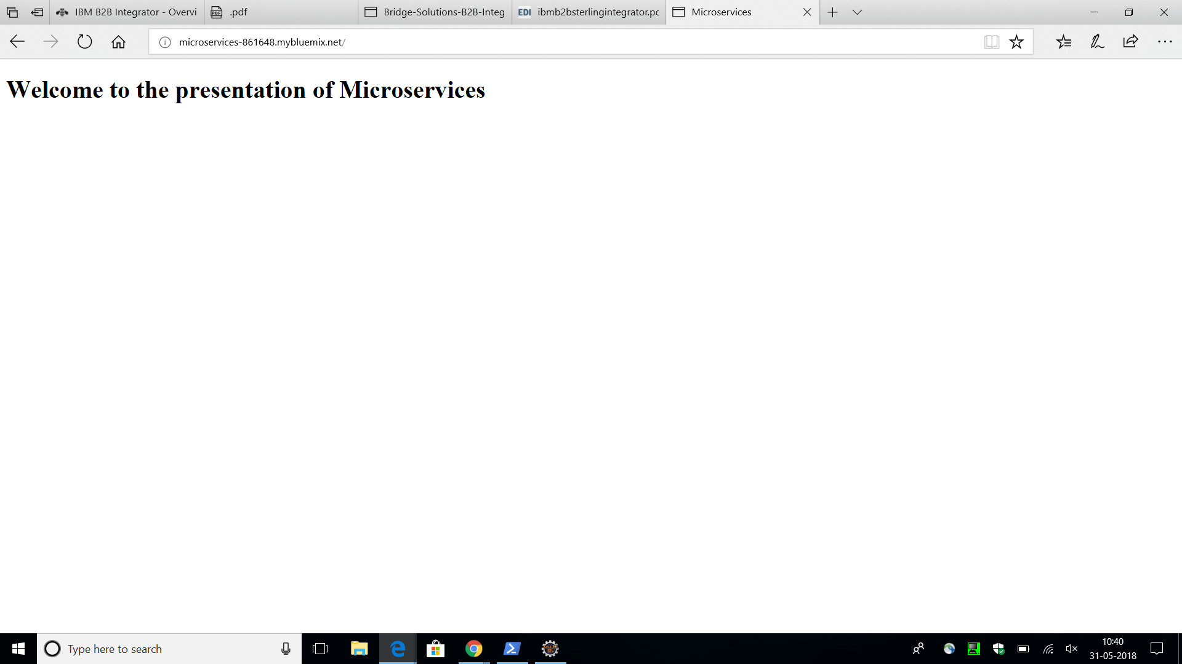
Application is deployed and running on browser.

